Slide 1
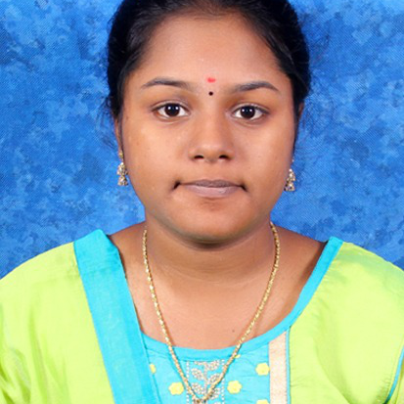


Kakumanu Devi Anjani PadmaSri
Bachelor of Technlogy, Computer Science and Engineering : 2016 - 2020
Analyst/Software Engineer
Skills
C#​ | C# Basics,OOPS,Generics,​ Collections, Array,Loops,LINQ​
.NET​ | ADO.NET,ASP.NET with MVC5 and WEB API,Entity Framework​
React​ | Components, Hooks, Virtual DOM, Routing, Forms & Validation​
Database​ | Microsoft SQL Server ​
UI Tech​ | HTML 5 & CSS 3,JavaScript, ES6 & TypeScript ,Optimized UI Design
Cloud | Microsoft Azure training ongoing
Tools​ | Git, PostMan,SSMS,Visual Studio, Visual Studio Code​
Add On skills​ | Immersive Learning​
Bangalore
kakumanu-devi-anjani-padma.sri@capgemini.com
+918985205805
A4
Full Stack Developer
Hands on experience on C#,ADO.NET,LINQ, Entityframework, SqlServer, ASP.NET MVC5 with WEB API
Proficient in creating Single page Web Application in React with Authentication with routing
Hands on experience in developing web pages using HTML5, CSS, Object TypeScript, Good understanding of Document Object Model (DOM) and DOM Functions
Ready to learn new technologies and implement them for the future knowledge improvement.
Online Railway Reservation System [ Video Profile]
Case study of Online Railway Reservation System along with API Gateway, Swagger, responsive UI with HTML5, CSS, Bootstrap and React used as User Interface.
Degreed :Successfully completed the degreed training in git, html, CSS, SQL, C#, .NET Core, React.
Check out my work on GitHub

